Slide 1

VPN tunneling
Oksana Baranova & Arthur Carels
Professors: Tuomas Aura, Aleksi Peltonen
January 2021

Slide 2
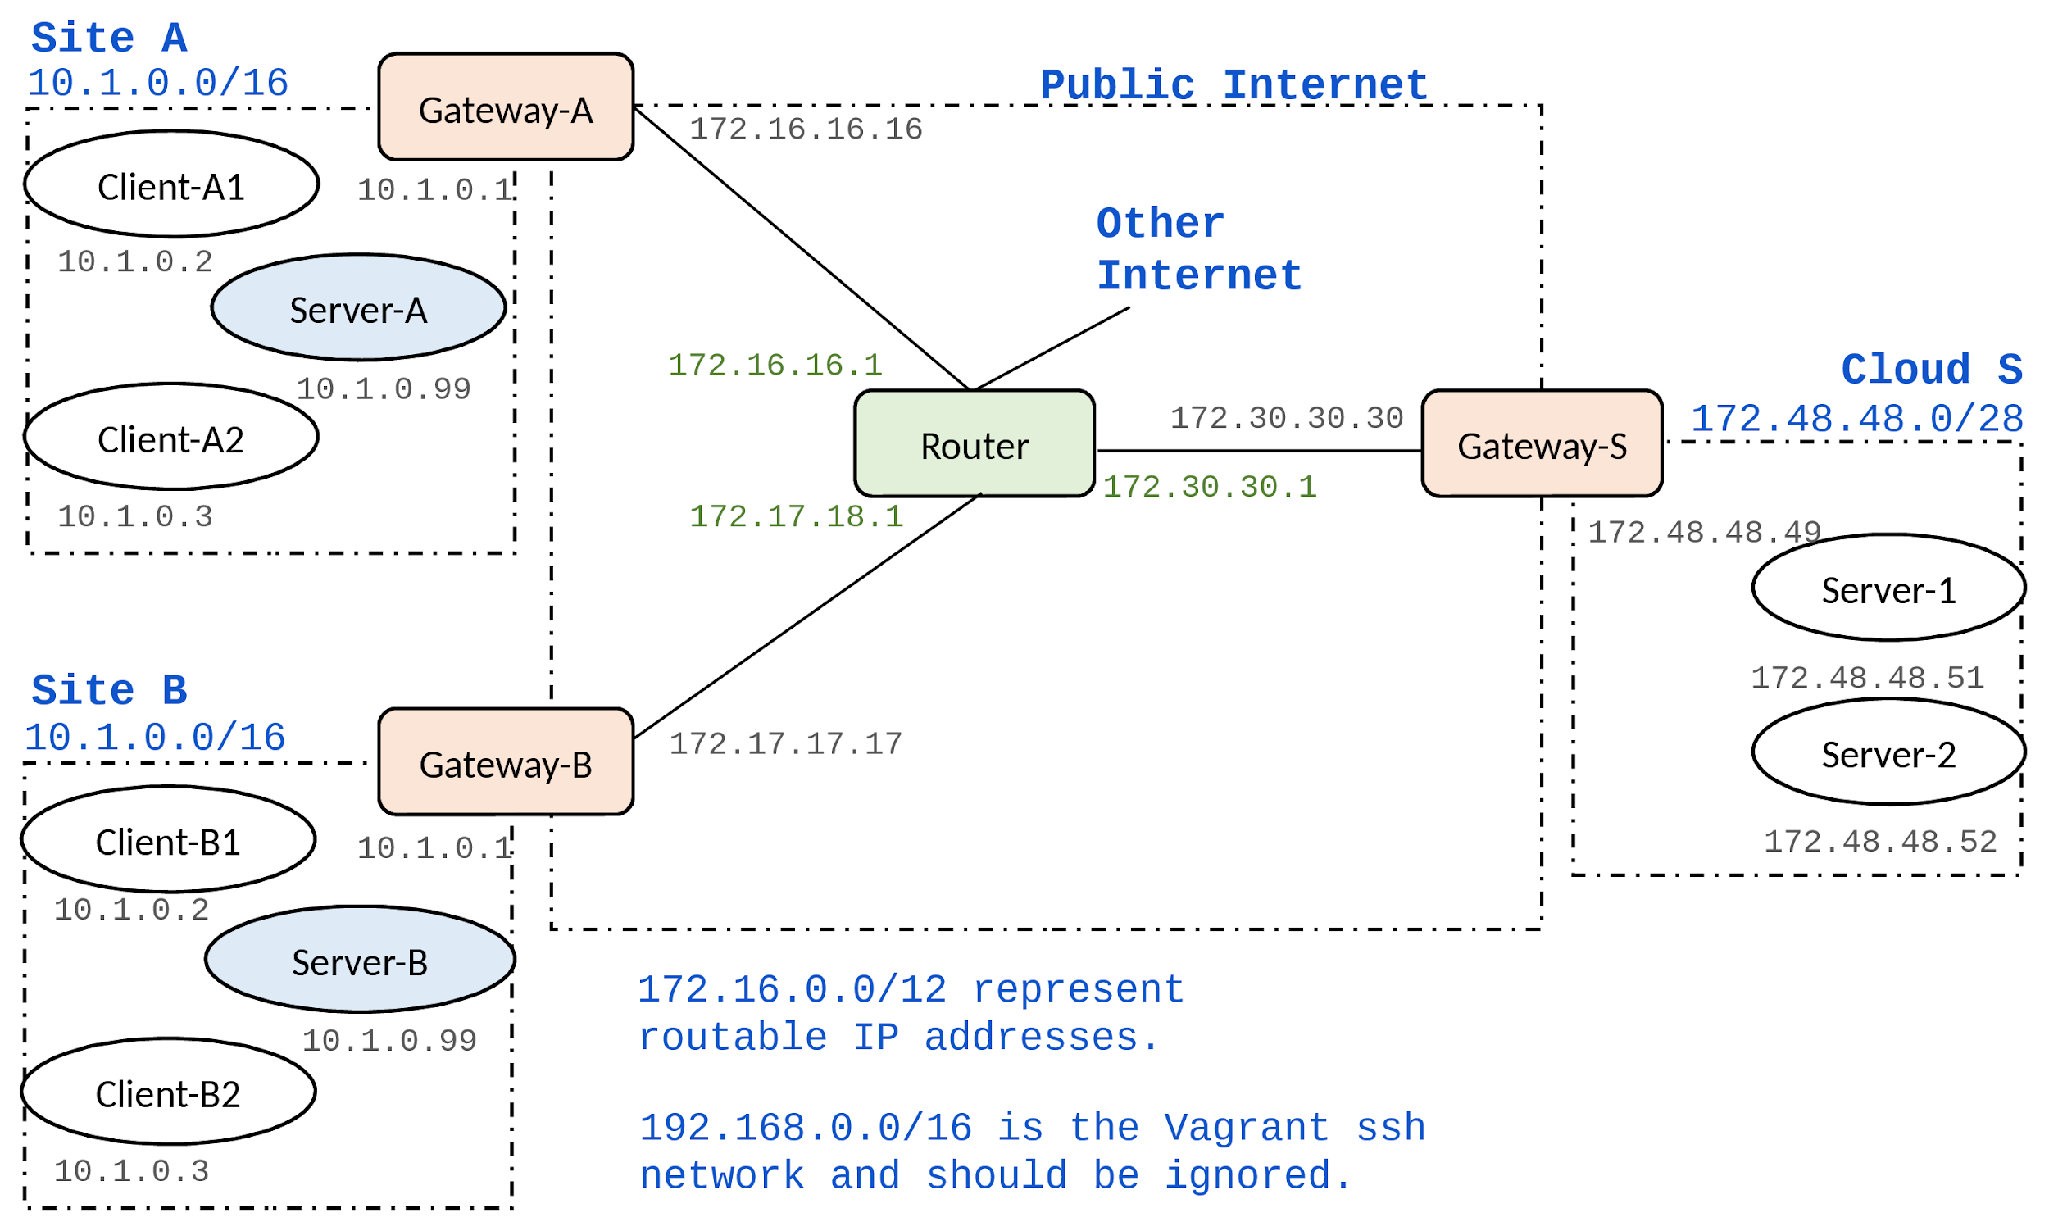
10.2.0.0/16 address space is used on the cloud side

Slide 3
GOALS
VPN tunnel between clients and cloud servers
Traffic in tunnel encrypted (ESP)
Set up proper routing rules
General security

Slide 4
SOLUTION
Authentication by secret
Creation of private subnetwork for servers (10.2.0.0/16)
iptables: → NAT port forwarding

Slide 5
Gateway configuration
etc/ipsec.conf
conn S_TO_A
type = tunnel
authby=secret
left=172.30.30.30
leftsubnet=172.30.30.30/32
right=172.16.16.16
rightsubnet=172.16.16.16/32
ike=aes256-sha2_256-modp2048!
esp=aes256-sha2_256!
keyingtries=0
ikelifetime=1h
lifetime=8h
dpddelay=30
dpdtimeout=120
dpdaction=restart
auto=start
/etc/ipsec.secrets
# This file holds shared secrets for authentication.
172.30.30.30 172.16.16.16 : PSK "dKVLhZa/cXQg2x3CCRxUYqfQPFMp0HO2"
172.30.30.30 172.17.17.17 : PSK "syMhWOzOvfwoQ9lg/C6q/+DSJEEOkIWO"
Keys generated via
head -c 24 /dev/urandom | base64
→ Randomness

Slide 6
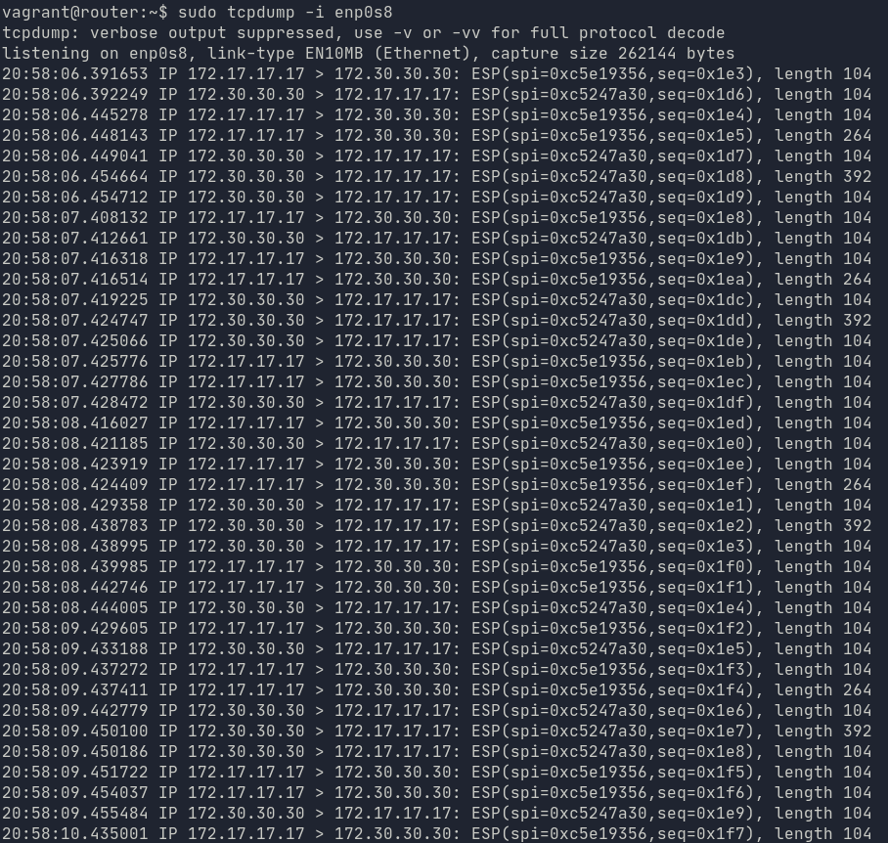
Working tunnel
(router): sudo tcpdump -i enp0s8
Note: All traffic is encrypted
Note: Only public addresses of gateway are exposed

Slide 7
Questions + demo

